Slide 1
Overview of Child Baker Acts and Improvements through House BILL (HB) 945
Shila salem, Assistant deputy secretary
DCF Substance Abuse and Mental Health

Slide 2
Overview
Between May 2020 and July 2022, the Department of Children and Families (DCF) and the Agency for Health Care Administration (AHCA) collaborated very closely to focus on House Bill (HB) 945 to:
Identify children and adolescents who are the highest users of crisis stabilization services.
Take appropriate action within available resources to meet the behavioral health needs of such children and adolescents more effectively.
Submit joint quarterly reports to the Legislature listing the actions taken by both agencies to better serve such children and adolescents.

Slide 3
DCF and AHCA’s Behavioral Health System of Care
DCF and AHCA are responsible for operating a system of care responsible for the medical and behavioral health of individuals living with chronic health conditions such as serious mental illness (SMI) or substance use disorder (SUD).
DCF serves as the single state agency for the provision of mental
health and substance abuse services.
AHCA serves as the single state agency responsible for administering the Florida Medicaid program.

Slide 4
DCF’s Roles and Responsibilities for Behavioral Health Services in Florida
DCF is the single state agency for Substance Abuse and Mental Health, Substance Abuse licensure, and the State Opioid Treatment Authority.
The Department is responsible for:
Safety net services for over 236,000 uninsured and underinsured individuals;
Care coordination to improve access to services;
Leadership for evidence-based policies and programs; and
Contracting with the state's seven Managing Entities.

Slide 5
Department of Children and Families
M A N A G I N G E N T I T I E S
Northwest Florida Health Network
Broward Behavioral Health Network
Central Florida Cares Health System
Lutheran Services Florida
South Florida Behavioral Health Network
Southeast Florida Behavioral Health Network
Central Florida Behavioral Health Network
S E R V I C E A R R A Y
Psychiatric Services
Crisis Stabilization Units
Short Residential Facilities
Statewide Inpatient
Psychiatric Program
Rehabilitation
Therapeutic Group Care Services
Outpatient Services
Case Management
Community Action Teams
Primary Prevention
Recovery Supports
Intervention Services
Therapy

Slide 6
What is the Baker Act?
The Baker Act is a Florida law that enables families, health care providers, law enforcement officers, or other professionals to seek emergency mental health services and temporary detention for people who are impaired because of their mental illness, and who are unable to determine their own needs for treatment.
AHCA is responsible for the licensure of:
Crisis Stabilization Units (CSU) which are designated as Baker Act receiving facilities;
Hospitals which may choose to be a Baker Act receiving facility; and
Short-Term Residential Treatment Facilities (SRT) which are affiliated with Baker Act receiving facilities.
DCF is responsible for the designation of Baker Act receiving facilities.

Slide 7
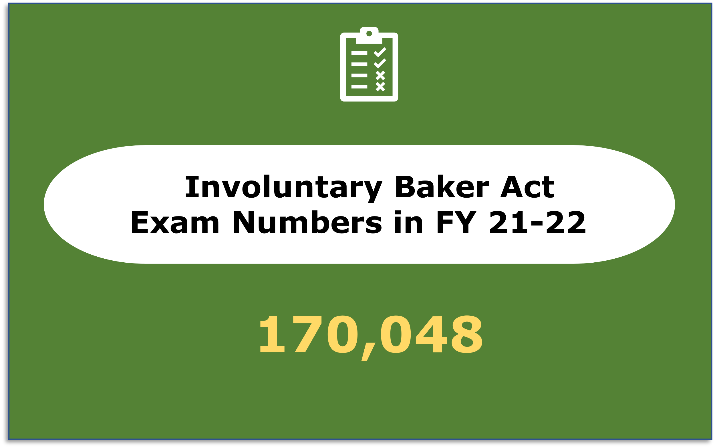
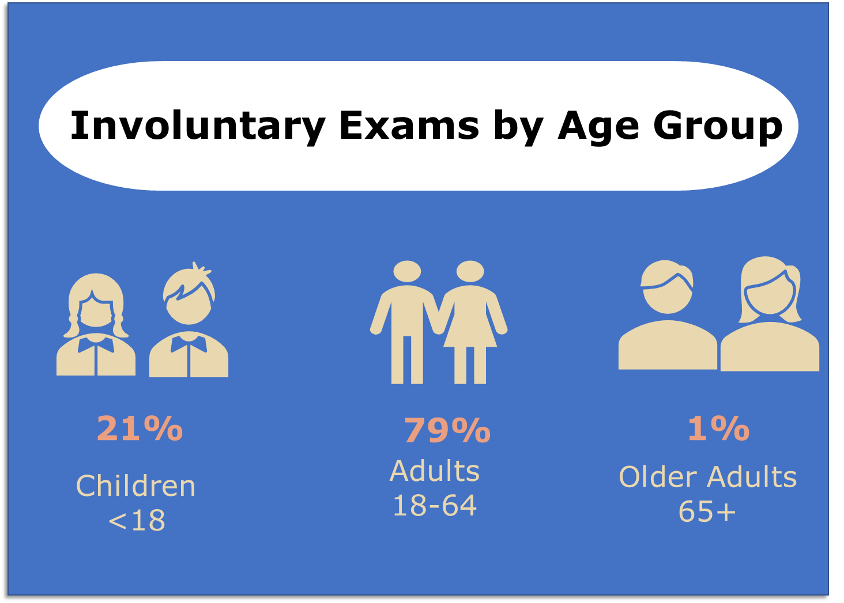
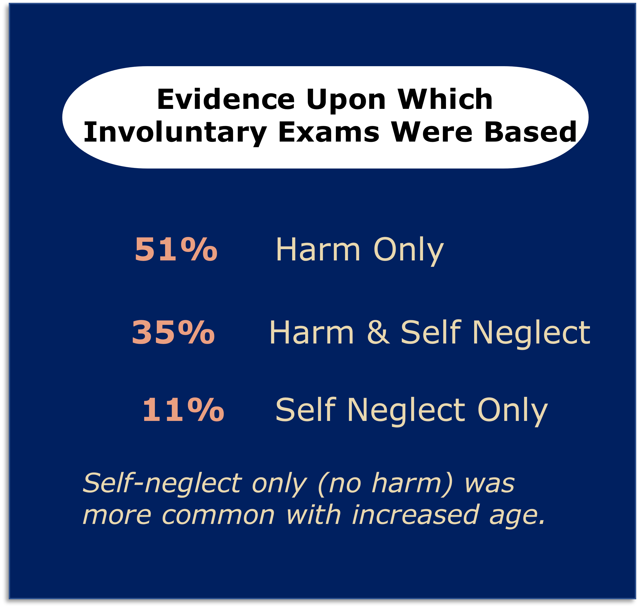
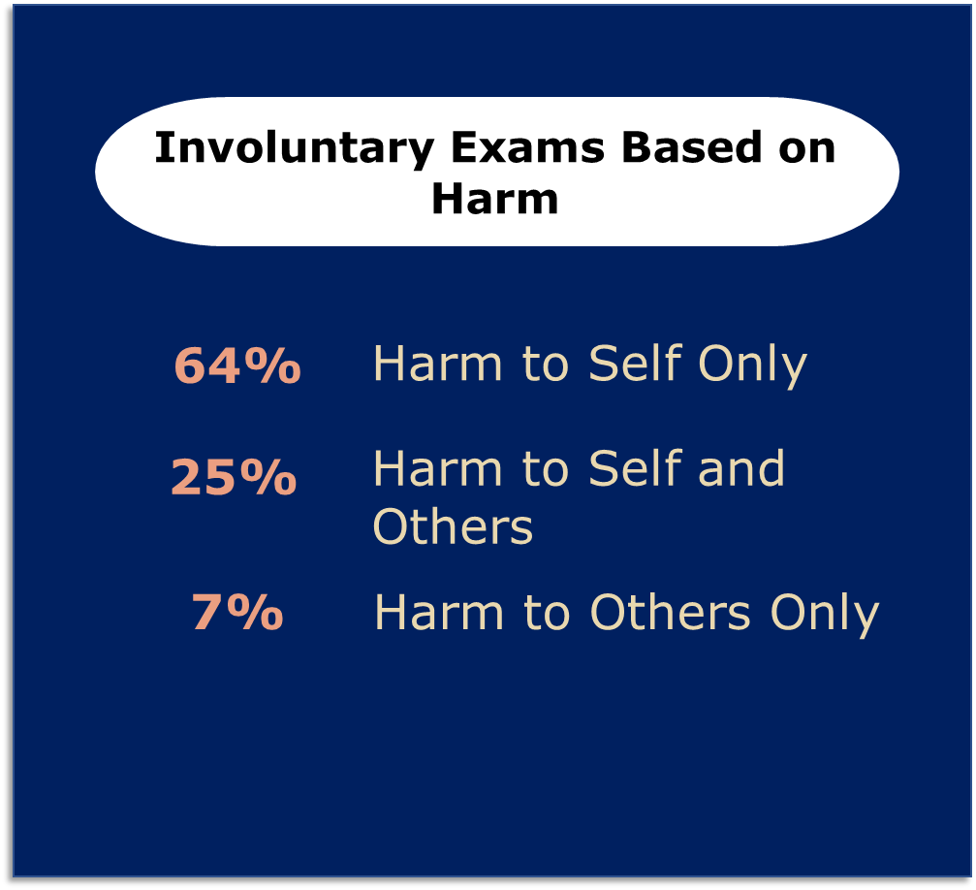
FISCAL YEAR 2021-2022 FLORIDA BAKER ACT DATA

Slide 8
FLORIDA BAKER ACT HISTORICAL DATA

Slide 9
HB 945 High Utilizers Definition
Children and adolescent high utilizers are defined as those under the age of 18 with three or more of the following encounters within six months:
Behavioral health related admissions to a crisis stabilization unit; or
Inpatient psychiatric hospitalizations.

Slide 10
DCF High Utilizer Data by Age, Race and Gender
RACE
Race | Number of Children | % of Total Children
White | 39 | 43.8%
Multi-Racial | 13 | 14.6%
Black | 35 | 39.3%
Other | 2 | 2.2%
Total | 89 | 100.0%
AGE
GENDER
Female | Male
52 | 37
58.4% | 41.6%

Slide 11
DCF High Utilizer Data by Diagnosis
Top Three Primary Diagnoses
1
2
3
Disruptive Mood Dysregulation Disorder
Mental Disorder, not otherwise specified
Attention Deficit Hyperactivity Disorder, combined type

Slide 12
Medicaid High Utilizer Data by Age, Race and Gender
RACE
Race | Number of Children | % of Total Children
White | 389 | 36.1%
Not Determined | 286 | 26.6%
Black | 189 | 17.5%
Hispanic | 148 | 13.7%
Other | 91 | 8.4%
Asian | 9 | .8%
American Indian / Alaskan Native | 1 | .1%
Statewide | 1,077 | 100.0%
AGE
GENDER
Female | Male
620 | 457
57.6% | 42.4%

Slide 13
Medicaid High Utilizer Data by Diagnoses
TOP THREE HOSPITAL DRGs BY GENDER | TOP THREE HOSPITAL DRGs BY GENDER
FEMALES | FEMALES | MALES | MALES
68.1% | Bipolar Disorders | 76.8% | Bipolar Disorders
56.6% | Major Depressive Disorders & Other/Unspecified Psychoses | 36.3% | Childhood Behavioral Disorders
19.0% | Depression Except Major Depressive Disorder | 33.5% | Major Depressive Disorders & Other/Unspecified Psychoses
TOP THREE PRIMARY DIAGNOSES
1
2
3
Bipolar Disorder, Unspecified
Major Depressive Disorder, Recurrent Severe w/o Psych Features
Disruptive Mood Dysregulation Disorder

Slide 14
Actions Taken: Children's Care Coordination
In FY 22-23, 789 children identified as acute care high utilizers received Care Coordination services.
DCF’s regional Children’s Care Coordination program embraces a proactive approach to identifying children who have had multiple admissions into a CSU.
Program goal to deliver effective, responsive, and high-quality services that follow the child throughout the system of care and connect the family to resources and services.
Children’s care coordinators work directly with children and their families; participate in local staffing meetings; connect families with services and supports; visit CSUs, Statewide Inpatient Psychiatric Program (SIPP) facilities, Community Action Treatment (CAT) teams, and Mobile Response Teams (MRT) providers; and engage in efforts to reduce high utilization.

Slide 15
Actions Taken: Baker Act Data Portal
The Department rolled out a new Baker Act Data Portal in July 2023.
To date there have been over 13,319 submissions.
The portal gives the Department almost real time data about individuals being Baker Acted.
This will revolutionize the Department’s ability to identify individuals with repeat Baker Acts, even when they go to different facilities, and regardless of payer source.
The Department is working to make a public facing dashboard available next year.

Slide 16
BAKER ACT DATA COLLECTION INITIATIVE
Web-based Application
Public-facing Dashboard
Electronic Coversheet
An electronic form in development to replace the coversheet.
Receiving facilities will complete the electronic form and scan copies of initiation forms into a new web-based application.
Enhanced efficiency, reduced paperwork and cost, and access to near real-time data.

Slide 17
Baker act data collection benefits
The Department
The Department continues to invest in technology enhancements and innovations that allow us to analyze data in ways that help us gain a deeper understanding of system challenges to improve outcomes in the people we serve.
Receiving Facilities
Designated Baker Act Receiving Facilities can view their number of submissions in-real time.
Baker Act Data Collection Initiative
Community Stakeholders
Stakeholders and community partners gain timely access to involuntary Baker Act data to make data-driven decisions in their communities to improve behavioral health crisis care.

Slide 18
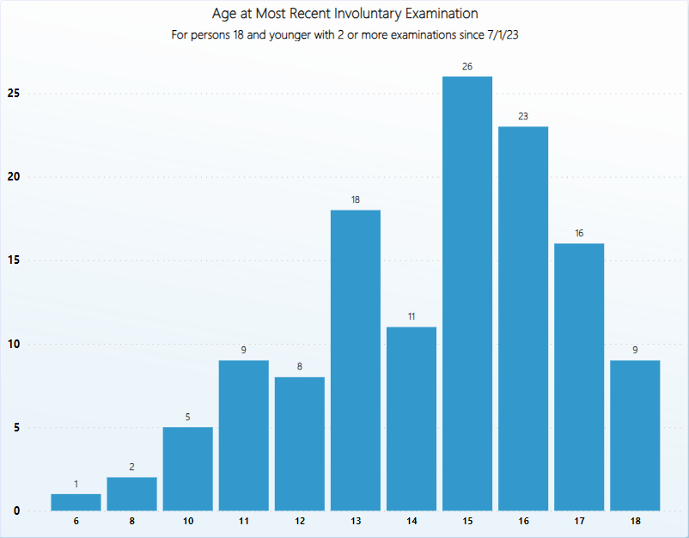

Slide 19
Provider feedback
“I'm having a great experience with the new Baker Act Data Collection system. The new system is usable friendly. Lastly, I love how I'm able to see a list of the Baker Acts that I send.” - South County Mental Health Center
“The new Baker act Data Collection system is very easy to use and complete. It provides a dashboard that is easy to maneuver and enter the data as well as track submissions. Very user friendly.” - First Step of Sarasota
“System is user friendly and the ability to edit is extremely helpful!” - PEMHS

Slide 20
Next Steps
Draft statutory language to define high utilizer; require implementation of policies and procedures regarding discharge planning for those identified as high utilizer; and strengthen discharge planning language for designated receiving facilities.
Evaluate the best ways to increase access and capacity, and whether additional services are needed.
Refine care coordination processes in response to data from the Baker Act portal.
Monitor newly implemented and expanded teaming services for outcomes and impact.

Slide 21
Questions?

